Slide 1

8. Key Partners (external)
6. Key Activities
2. Value Propositions
4. Users Relationship
1. Users
Institutions / Ministers of Health (MoH) from every EU region
Service providers =
API (Nokia servers) – Consultancy to update and validate our calculation/system
Translation services (e.g., Transperfect) – Boost an effective communication between patients and doctors
1- User access
2- Authorization request
3- User sync their medical records
4- Users adds their data
5- Users can request a translation service for their medical records
6- When user is travelling around EU, they can share data with health professionals.
7- Doctors can update information
8- Connection is over
Boost effective communication between doctors & patients while they’re travelling abroad.
Our aim is simplifying the ways of accessing medical records between countries.
Additionally, users will provide their data information once they are in a nearby hospital and their phone is open.
Otherwise, doctors won’t be able to access their medical records.
Furthermore, uses can translate their data using our translation services.
We’ll communicate with the user from our app. User can update their information and doctors can insert data there. They must feel confidence with the system.
Additionally, there is a translation service for serious disease with external providers.
We’ll receive feedback from users for continuous improvement.
Who?
-Beneficiary: patients with rare disease or disabilities and frequent travellers
-Institutions
-Doctors and health professionals
Why?
Many users use to struggle when they want to access medical data when they are far away from their assigned region in Europe.
Either they cannot insert new records, visualize data nor they cannot effectively communicate due to language barriers.
Our aim is improving our patient’s life by simplifying this procedure using our app.
7. Key Resources (internal)
3. Channels
Owner: EU & Our company
Headcount: 2 developers, 1 law assistance, 1 business analyst, 1 marketing, 1 CEO
Sponsors: Institutions, European Union, WHO and local governments
Related projects: EU patients summary
Software: NJs, PostgreSQL
Online platform: Our tool can be made available to all EU citizens through an online & mobile platform. We’ll organize trainings for awareness, receiving feedback, acting and engaging.
Externally our commitment will be communicated through MoH, local/European institutions, to our shareholders and patients through owned social media channels and presential events.
9. Cost Structure (mature phase)
5. Business Impact (mature phase)
External Service Providers = 1.2 M€ (API integration, data consistency, cybersecurity, validation, scalability, cloud services, maintenance…)
Marketing + Facilties= 1 M€
6 salaries around 70 k€ gross salary (average): 0.7 M€
Contingency 10% of above costs (total of 590 k€) = 0.29 M€
Total Project Estimate= 3.3 M€/year
154 M of European citizens travelling around the EU [1]. If we earn 0.20€ by query and there’s 2% accident’s rate it means 616 k€/year.
Furthermore, up to 36 million people in the EU live with a rare disease. If they request a translation service, it could cost between 0.15-0.18€/word with a 25% gross margin.
The medical records length is around 4285 words. An estimated unitary potential margin could be around 192.8 €/translation. In case our market share could be 0.1%, our estimated revenue would be 6.9 M€. It could be granted by public organizations.
Hence, the Total Estimated revenue= 7.5 M€/year

Slide 2


Current situation
“154 million of EU citizens travelling around Europe”, INE
“36 millions of EU citizens with serious rare disease are concerned about travelling around”, EU Comission
By Bilel Dario Kalem, Armando Medina & Aleix Sicilia

Slide 3






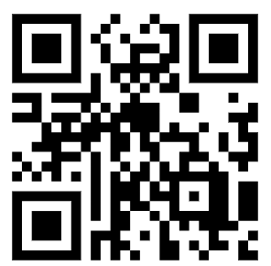
Our idea
Speaks
International hospital
Speaks
PRIVACY: Only sharing data if user is registered, we gather their phone location and we check if the patient is close to a hospital
TRANSLATION SERVICE
LOGIN DETAILS
doctor@test.com
test1234
Our solution
TRAVEL HEALTH PASS

Slide 4
Value proposition
Visualize your medical records and update information
Data privacy: Check if you’re registered and close to a hospital
Translation about sensitive data
Can a miscomunication impact the patient’s life?
4
MWC’24 – GROUP 8TH

Slide 5
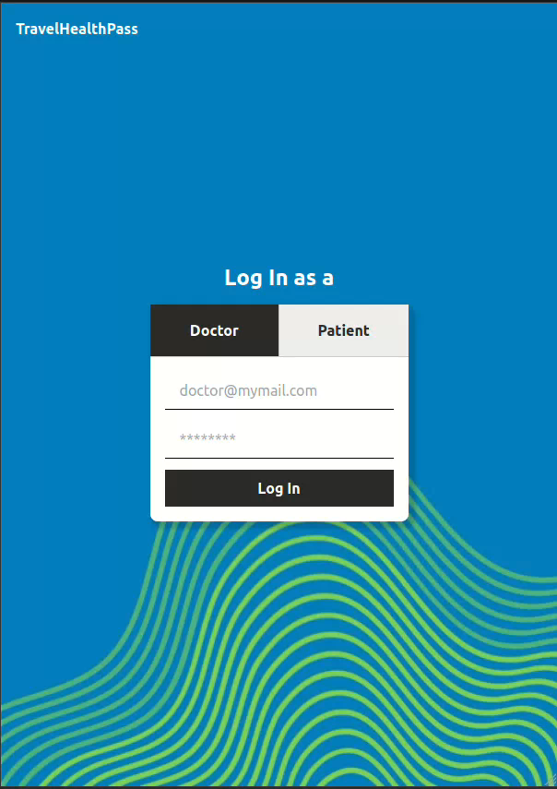

APP USAGE as a doctor
3 APIs: LOCATION RETRIEVAL + LOC. IDENTIFICATION+ STATUS +
1 VISUALIZATION WITH BI +
1 Potential API: Specialized Network
LOGIN DETAILS
doctor@test.com
test1234
EMAIL FOR REQUEST ACCESS
lee@vercel.com

Slide 6
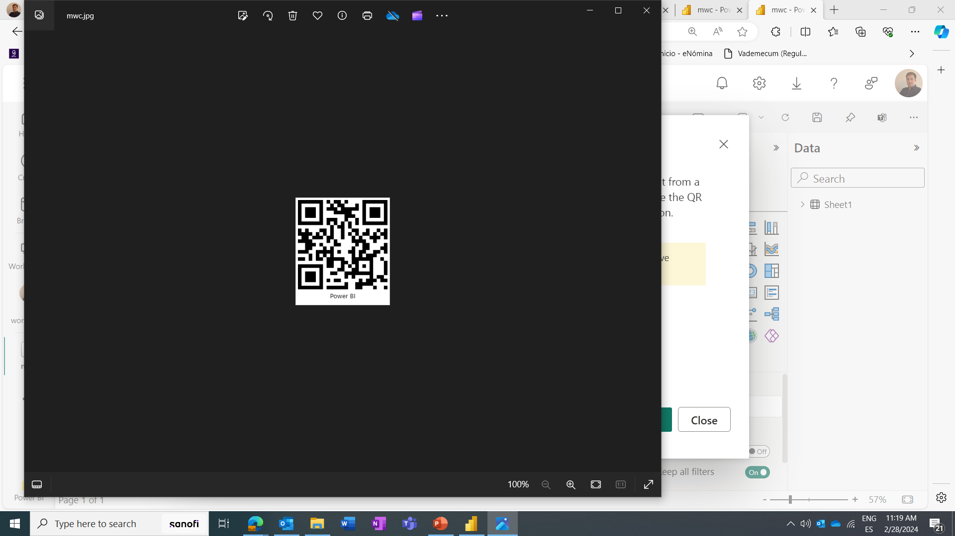
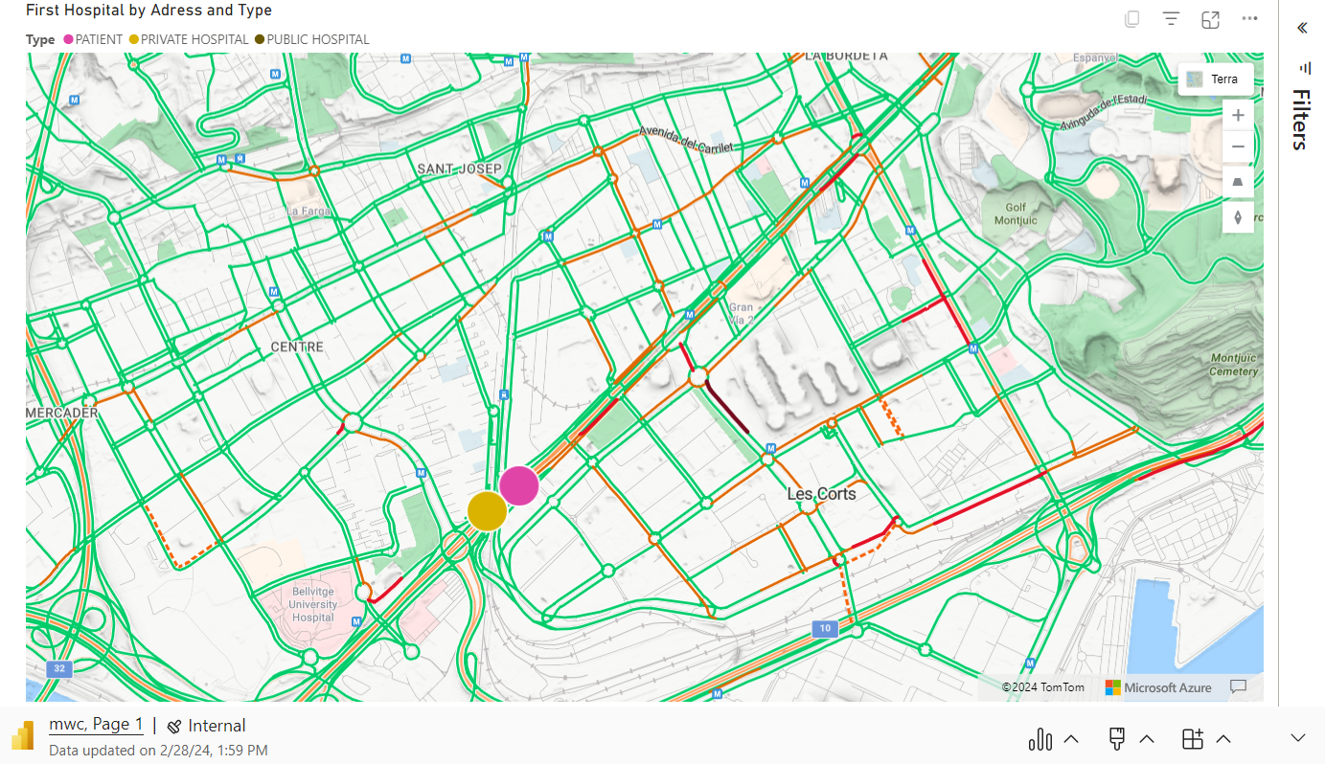
App usage as a patient
Find the nearest hospital
On top of the user’s view to upload their medical records
LOGIN DETAILS
doctor@test.com
test1234
EMAIL FOR REQUEST ACCESS
lee@vercel.com

Slide 7




Main users
TRAVELLER with an accident
PATIENT
DOCTOR
EXECUTIVE IN MINISTER OF HEALTH

Slide 8





Our added value
CONNECTING DATA BETWEEN DOCTOR & PATIENT
CONFIDENCE
STRICT PRIVACY BETWEEN MEDICAL SYSTEMS
TRANSLATION
CONFORTABLE IN STRESSFUL SITUATIONS
FROM ALL EU LANGUAGES TO ALL

Slide 9

Business impact (mature phase)
* Figures are justified in the business plan
Expected revenue
Translation services = 6.9 M€/y
Queries cost = 0.6 M€/y
Cost Structure
External Provider (1.2M€), 11 salaries (0.7M€), Marketing (1M€), contingency (0.29M€)
Total = 3.3 M€/y
Social impact + Expected profit 4.2M€

Slide 10




SCALABILITY
KEY partners
2024+: Next steps
Integration with each local system and translation Service providers
Regulatory affairs due to european data privacy laws
Increased security & data storage capacity
Others
Institutions, insurance companies and EU commission
SERVICE PROVIDERS: Nokia and SQL databases
TRANSLATION Services
Long-term goals: Purpose-driven company
Expand our services while we support our patient’s journey

Slide 11
required APIS
-Device location
-Device Status
-Specialized Network (SCALABILITY)
Required software
-NextJs
-PostgreSQL

Slide 12

BIBLIOGRAPHY
[1] Instituto Nacional de Estadístico. (01 de 2024). Número de turistas según país de residencia(10822) (ine.es). Extracted from https://www.ine.es/jaxiT3/Tabla.htm?t=10822&L=0
[2] European Commisions, Public Health. (2024). Rare diseases. Extracted from https://health.ec.europa.eu/european-reference-networks/rare-diseases_en
[3] Steinkamp, J., & Kantrowitz,, J. (s.f.). Prevalence and Sources of Duplicate Information in the Electronic Medical Record. Extracted from https://jamanetwork.com/journals/jamanetworkopen/fullarticle/2796664#:~:text=The%20median%20patient%20record%20length,1%2D116%20964%20words).
CONCEPTS:
EU=European Union
MoH=Minister of Health
NJs=Code language
WHO= World Health Organization
Data reference

Slide 13

THANK YOU!

